Slide 1
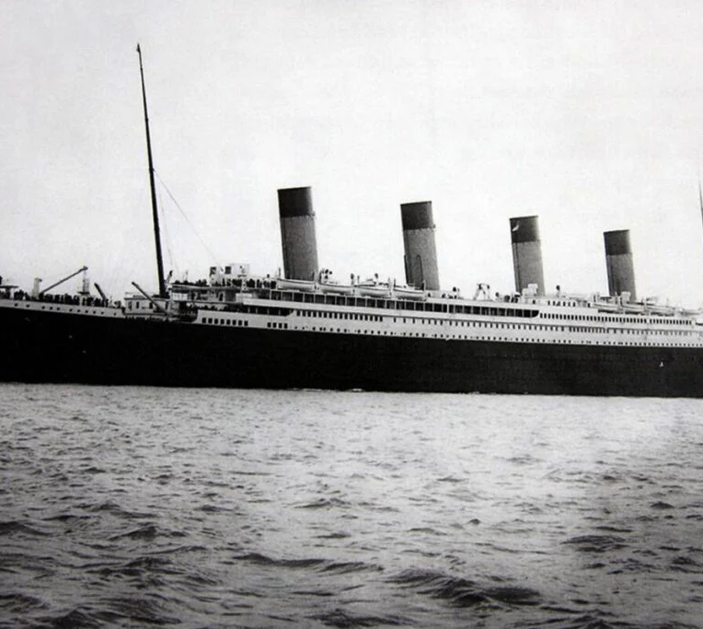
Tıtanıc Survıval
Introductıon to deep learnınG
Ömer Kurtuldu 152120191007
Göknur Sevinç 152120191013
Yusuf Aktaş 152120191032
Sinan Kompas 152120191070

Slide 2
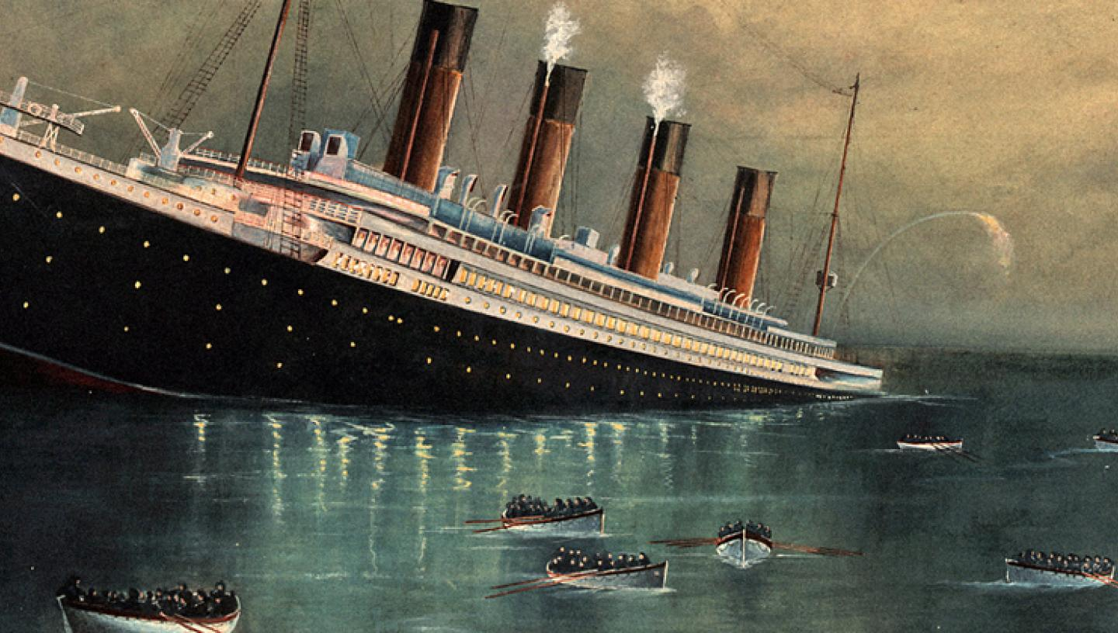
STORY OF THE TITANIC
On 15 April 1912, during her maiden voyage from Southampton to New York, RMS Titanic, the largest commercial ship afloat at that time, collided with an iceberg and sank to the bottom of the Atlantic Ocean.
More than 1500 of the 2,224 passengers and crew on board perished in this infamous tragedy.
2

Slide 3
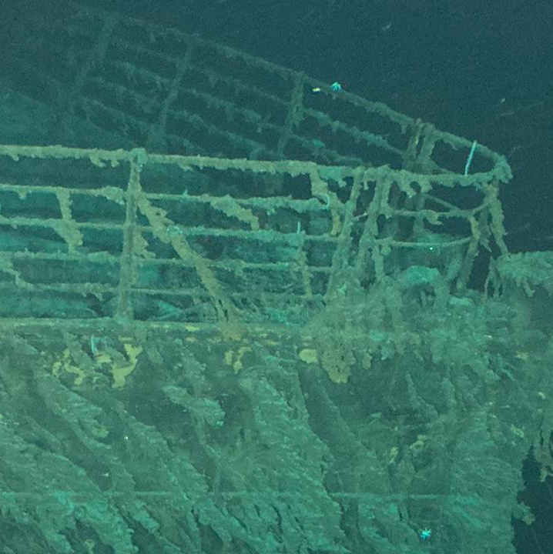
Project topıc
This project aims to analyze Kaggle's Titanic dataset, which provides information about passengers on the ill-fated Titanic ship.

Slide 4


technologies used in the project
Flask Framework
Pandas
Scıkıt-learn (sklearn)
Flask was used to create and manage the web application. Flask is a lightweight web framework based on Python and is used to quickly develop web applications.
In this project, pandas was used to convert incoming JSON data into DataFrame and perform data preprocessing steps.
In this project, the StandardScaler class is used to scale the data.
TensorFlow ve Keras
Joblıb
This project used TensorFlow and Keras to load and use a trained neural network model.
In this project, joblib is used to store and load the scaler object used for the scaling process.

Slide 5
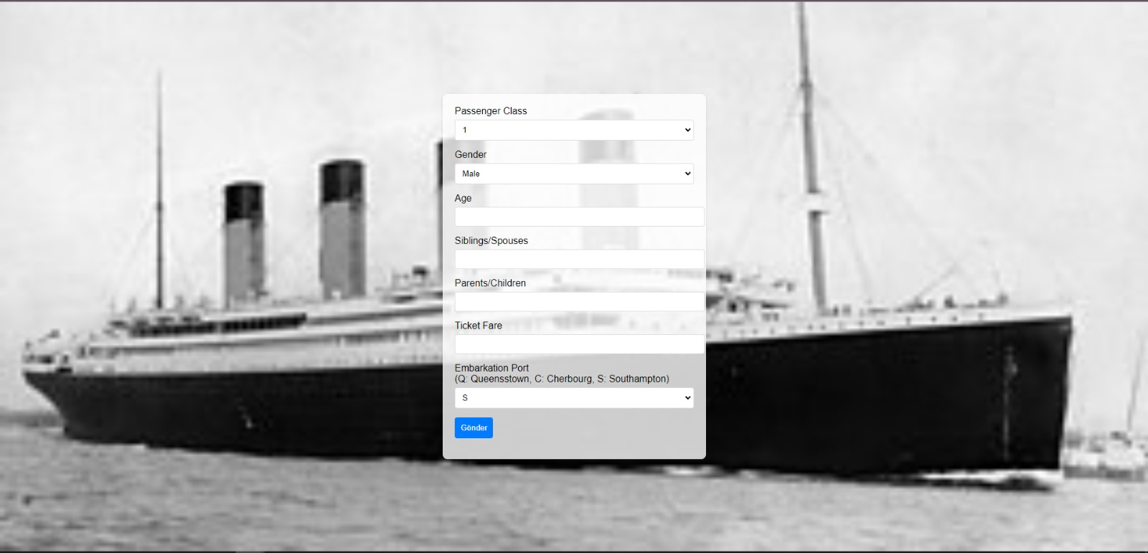
Websıte desıgn
A user-friendly web page design was created using HTML and CSS.
The entry form allows the user to easily enter "Passenger Class, Gender, Age, Siblings/Spouses, Parents/Children, Ticket Fare, Embarkation Port" data.
Form data processed with PHP is passed to the model trained with TensorFlow.js in the background.

Slide 6
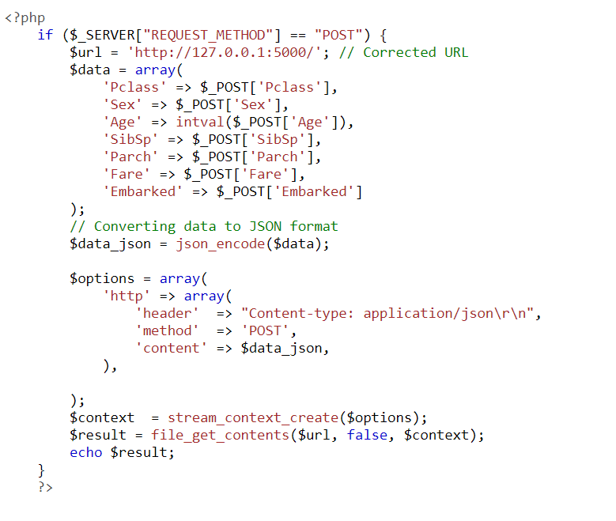
Data Transmıssıon and Processıng
On the PHP side, the data received from the user is converted to JSON format.
The transformed data is sent via TensorFlow.js to the Flask application where the trained model resides.

Slide 7
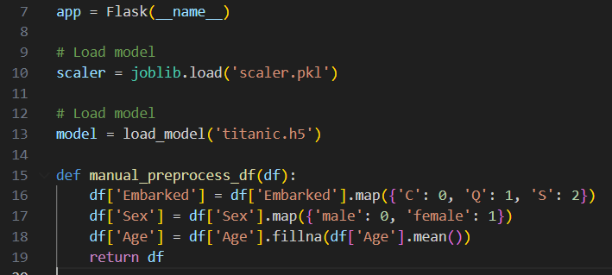
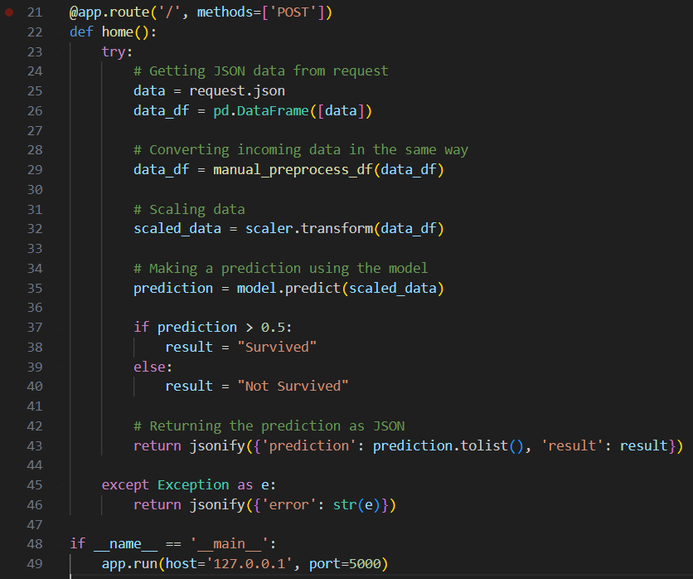
Flask App and Model Estimation
The Flask application receives and processes incoming JSON data.
Data preprocessing steps are brought into a format that the pre-trained model can understand.
The data is predicted by the model and the result is compared to a specified threshold value.

Slide 8
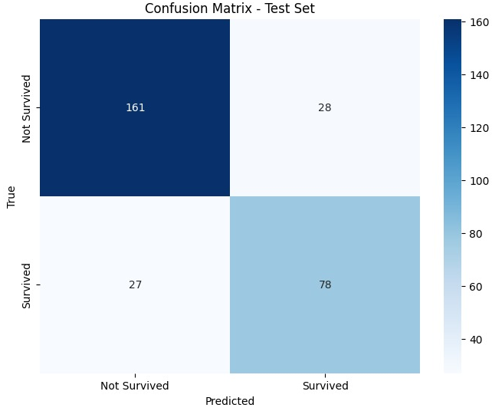
Confusion matrix
True Negatives (TN): The model correctly predicted that 161 passengers did not survive.
False Positives (FP): The model predicted that 28 passengers did not survive, but these passengers survived the crash.
False Negatives (FN): The model predicted that 27 passengers survived, but these passengers did not survive.
True Positives (TP): The model correctly predicted that 78 passengers survived.
The performance of the model in the project is as follows:
Accuracy: %81.29
Precision: %73.58
Recall: %74.29
F1 Score: %73.93

Slide 9
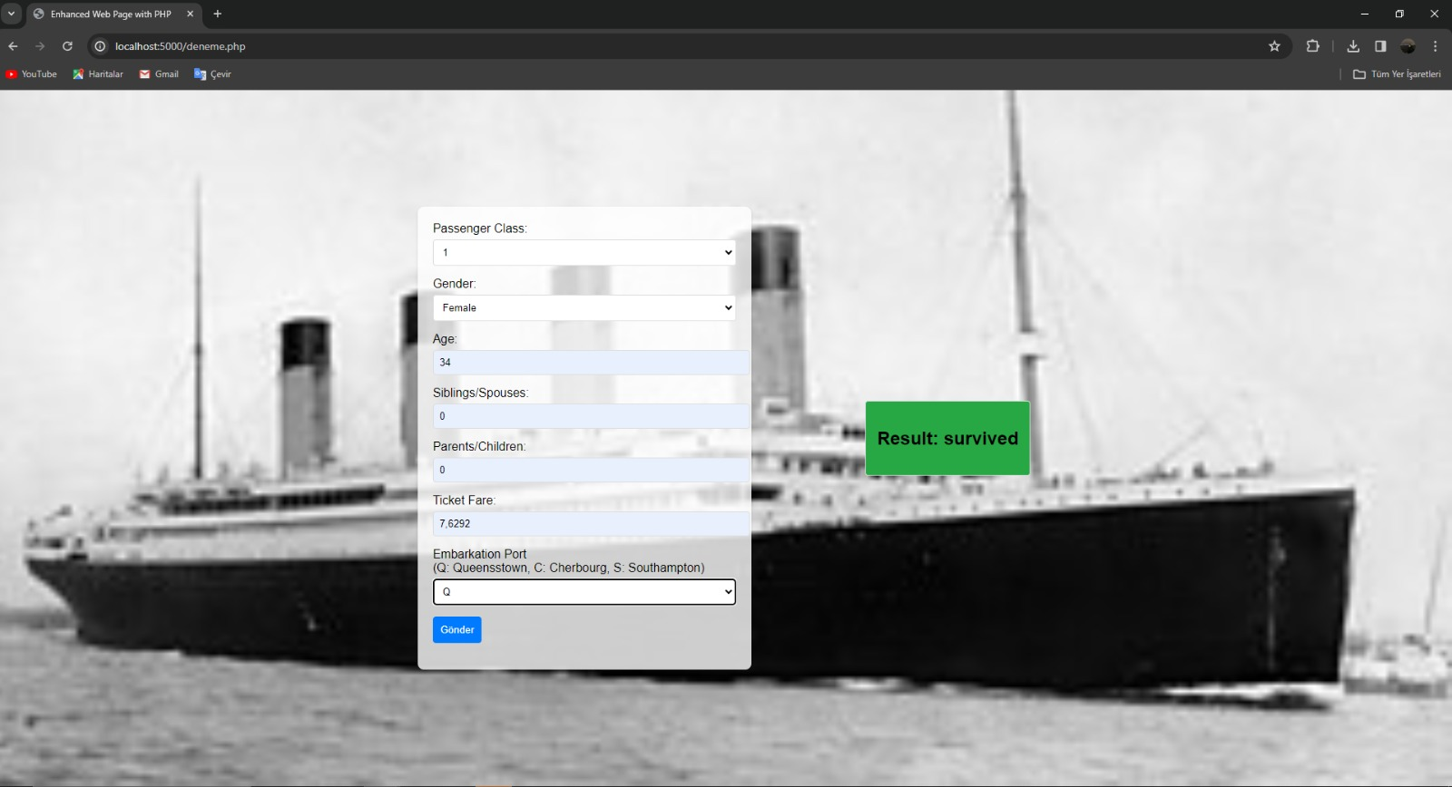
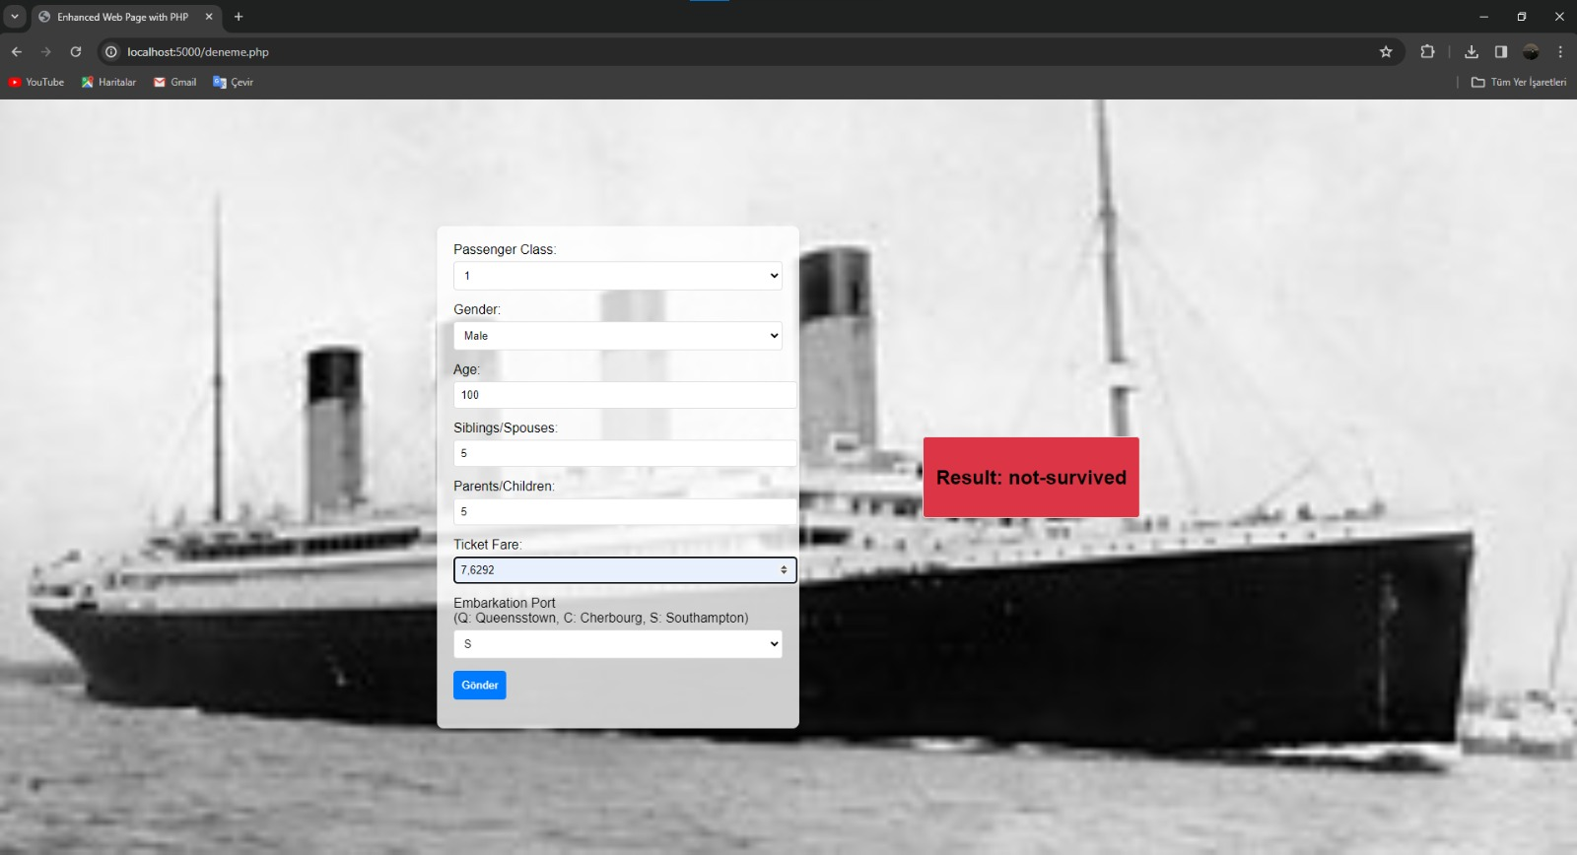
Results
The project can successfully process data received from the user and predict the probability of survival.

Slide 10

Thank you

